Slide 1
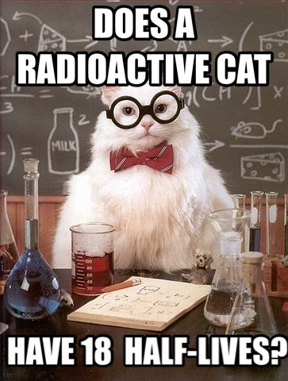
Radiation Hardness in Semiconductors
Chris Bankers
4/29/2016
Abstract: The effects of radiation can be permanently damaging to a device. Failure of these circuits can result in the loss of multi-million dollar products and human life. To diminish radiation effects, “Radhard” devices have been fabricated and used in several industries. We will discuss how radiation effects devices, how these effects can be prevented, and some real world Radhard devices used today.

Slide 2
Radiation Effects on Semiconductor Devices:
Semiconductor devices are affected by 2 general types of radiation damage:
Displacement Damage: Where incident radiation displaces Si atoms from their lattice sites which alters the electric characteristics of the crystal.
Ionization Damage: When a high-energy particle travels through a semiconductor, it leaves an ionized track behind. Energy absorbed by the electric ionization in insulating layers (ex. Si02) pushes out charge carriers which leads to unintended concentrations of charge. This in turn creates parasitic fields inside the device.
Note: Devices vary in their sensitivity to these effects; it depends primarily on the type of radiation encountered and the nature to the specific device.

Slide 3
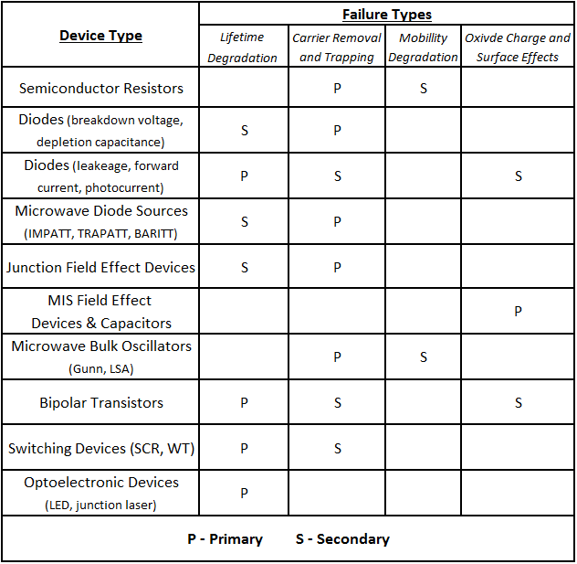
Types of Device Failure:
Devices which depend on resistivity or
majority carrier concentration for their
operation fail mostly to carrier removal or trapping.
~ Ex: Semiconductor resistors, diodes, and field-effect devices
Devices based on minority carrier concentration
for their operation degrade due to
lifetime effects.
~ Ex: Bipolar resistors, optoelectric devices,
and switching devices
[1]

Slide 4
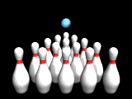
Displacement Damage:
Caused by neutrons, protons, alpha particles, heavy ions, and very high energy gamma photons.
Note: We’ll be focusing primarily on fast-neutron displacement effects since they’re representative of displacement damage in general.
This type of damage is the result of lattice atom displacements.
Lattice displacement significantly decreases carrier concentration, carrier mobility, and carrier lifetime.
Analogy:
Bowling ball = Fast Neutron
Bowling Pins = Lattice Structure of device

Slide 5
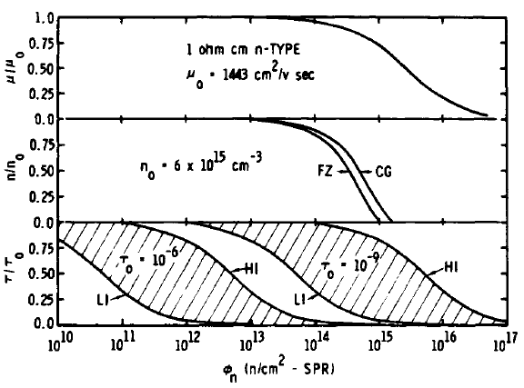
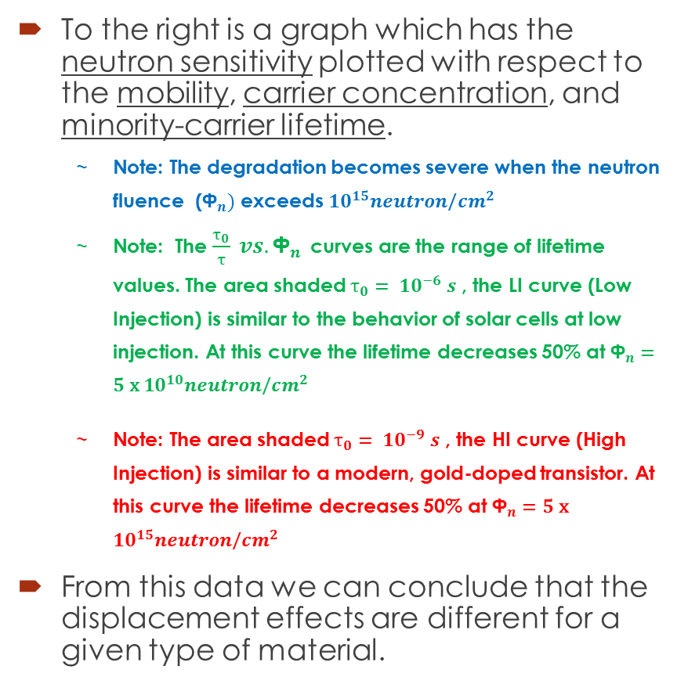
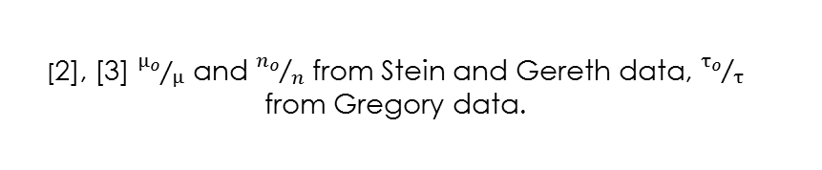
Fast-neutron displacement effects:
To the right is a graph which has the neutron sensitivity plotted with respect to the mobility, carrier concentration, and minority-carrier lifetime.
Note: The degradation becomes severe when the neutron fluence (${\text{Ф}}_{n})$ exceeds ${10}^{15}neutron\text{/}{cm}^{2}$
Note: The $\frac{τ_{0}}{τ} vs.{\text{Ф}}_{n}$ curves are the range of lifetime values. The area shaded $τ_{0}= {10}^{−6} s$ , the LI curve (Low Injection) is similar to the behavior of solar cells at low injection. At this curve the lifetime decreases 50% at ${\text{Ф}}_{n}=5 \text{x} {10}^{10}neutron\text{/}{cm}^{2}$
Note: The area shaded $τ_{0}= {10}^{−9} s$ , the HI curve (High Injection) is similar to a modern, gold-doped transistor. At this curve the lifetime decreases 50% at ${\text{Ф}}_{n}=5 \text{x} {10}^{15}neutron\text{/}{cm}^{2}$
From this data we can conclude that the displacement effects are different for a given type of material.
[2], [3] ${μ_{o}}/μ$ and ${n_{o}}/n$ from Stein and Gereth data, ${τ_{o}}/τ$ from Gregory data.

Slide 6
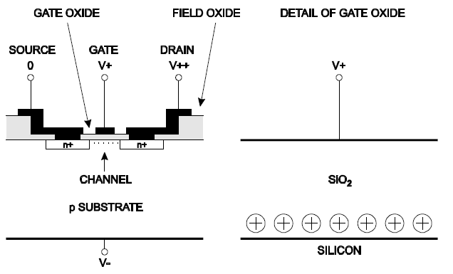
Visual aid of ionization:
Schematic cross section of an n-channel MOSFET (left).
Gate oxide with trapped holes at the oxide-silicon interface (right)
[4]

Slide 7
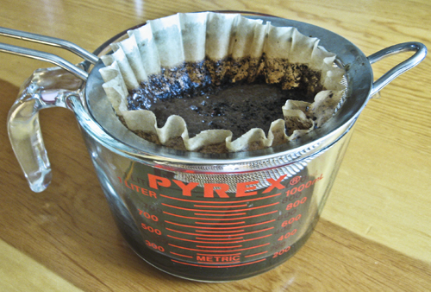
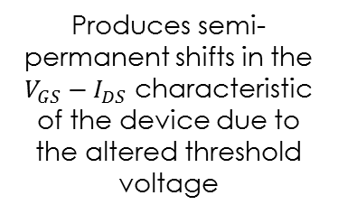
Ionization Damage:
Process of ionization in oxide layer:
Effects of this process:
Analogy:
Strainer = oxide
Coffee goodness that you drink = electrons
Gross sludgy grounds left over after straining = holes
High-energy particle goes device. Electron-hole pairs are created in the oxide.
Electrons (very mobile) move out to the most positive electrode.
Positive charges (holes) have lower mobility making them more likely to be trapped in the oxide.
Causes trapped-oxide charge to be positive due to the trapped holes
When a positive voltage is applied to gate electrode, it attracts electrons to the surface of Si beneath the gate.
Threshold voltage is forced to increase, since a larger applied voltage is required to maintain the negative charge of the channel
Produces semi-permanent shifts in the $V_{GS}−I_{DS}$ characteristic of the device due to the altered threshold voltage
The holes then freed by the radiation build up near the substrate

Slide 8
What types of devices are sensitive to ionization?
MOSFETs have very prominent ionization effects
Since MOS oxide links the gate to the channel, hole trapping becomes more of an issue.
Based on the geometric location of the trapped charge, P-channel (with already negative gate voltages) tend to be less sensitive to ionization compared to N-channel devices

Slide 9
Radiation-hardening techniques
Even though they’re extremely radiation hard, no… you can’t use vacuum tubes.
Modern electronics systems are too complex and tubes must be replaced after frequent use. This restricts our focus to ICs.
Two Approaches:
Physical | Logical
Deals with the manufacturing of semiconductor devices and choice of materials/device characteristics | Involves programming and digital logic to correct malfunctions in the hardware.
Ex.s: manufacturing on insulating substrates Bipolar transistors have higher radiation tolerance than MOS. | Ex.s: Use 3 separate microprocessor boards to independently compute tasks and compare their answers, if calculations vary, shut down incorrect board or have watchdog timer force a hard reset to the system.

Slide 10
More Physical Rad-Hardening Techniques:
Manufacturing on insulating substrates instead of the standard commercial semiconductor wafers.
Silicon on insulator (SOI) and on sapphire (SOS) are used frequently.
Using Bipolar integrated circuits since they have higher radiation tolerances than CMOS circuits. (Remember MOS’s are sensitive to Ionization)
The low-power Schottky (LS) 5400 series can withstand 1000 krad, and ECL devices can withstand 10,000 krad
Choosing a substrate with a wide band gap, which gives it higher tolerance to deep-level defects. (Ex: silicon carbide or gallium nitride)
Shielding the chips themselves with depleted boron (boron-10 naturally captures neutrons).
Optimizing oxidation growth (ex Dry Oxidation) helps keep impurities like sodium out of the oxide.
[5],[6],[7]

Slide 11
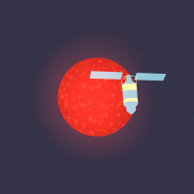
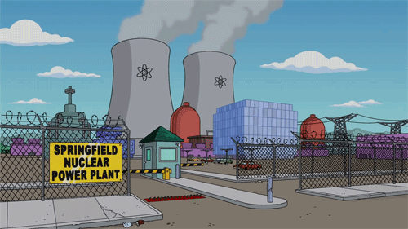
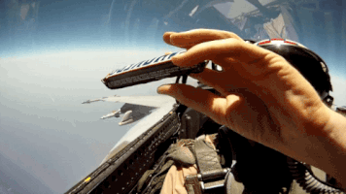
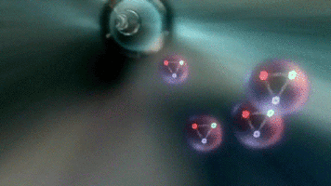
When should we consider the effects of radiation damage?
Radiation affects electronics in four environments:
Outer Space
High Altitude Flight
Nuclear Reactors
Particle Accelerators

Slide 12
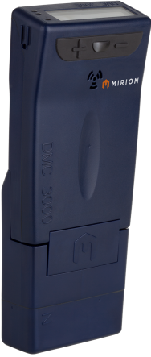

Product Example: Nuclear Power Plant Equipment
DMC 3000 Neutron Module, Electronic Radiation Dosimeter
Model detects neutron dosimetery using silicon PIN diode
[8], [9]

Slide 13
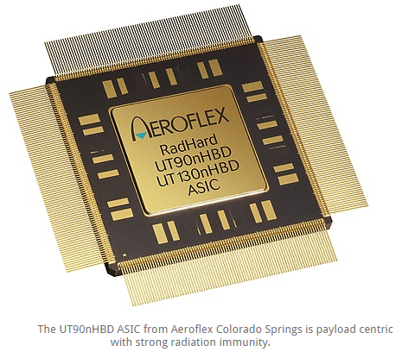
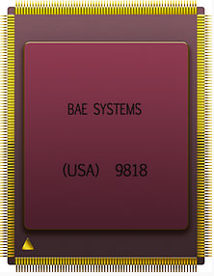
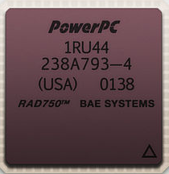
Product Example: Space
Satellite Command Data and Handling (CD&H) electronics
Needs more radiation hardening since they keep satellite in orbit. One product used is the UT90nHBD ASIC chip.
BAE Systems RAD6000
RAD6000 is mainly known as the onboard computer of NASA equipment.
As of June 2008, there are 200 RAD6000 processors in space on numerous NASA, DoD, and commercial spacecraft
BAE Systems RAD750
The successor of the RAD6000
In 2010 BAE reported that there were over 150 RAD750s used in a variety of spacecraft and satellites.
[10]

Slide 14
Negative effects and hurtles of Radhard devices:
They need extra transistors that take more energy to switch on and off.
They're expensive,
power hungry
slow -- as much as 10 times slower than an equivalent CPU in a modern consumer desktop PC.
SOI and SOS manufacturing is difficult when attempting to get Si onto a different crystal lattice substrate.

Slide 15
References:
[1] B. L. Gregory, “Radiation defects in devices”, in Radiation Damage and Defects in Semiconductors. London, England: Inst. Phys., 1972, pp 302-314.
[2] H.J. Stein and R. Gereth, “Introduction rates of electrically active defects in n- and p- type silicon by electron and neutron irradiation“, J. Appl. Phys., vol. 39, pp. 2890-2904, May 1968.
[3] B. L. Gregory, “Minority carrier recombination in neutron irradiated silicon”, IEEE Trans. Nucl. Sci., vol. NS-16, pp. 53-62, Dec 1969
[4] H. Spieler, “Introduction to Radiation-Resistant Semiconductor Devices and Circuits”, Beam Instrumentation AIP conf., Argonne, Illinois (USA), 1997, pp 6.
[5] K. Leppälä, R. Verkasalo "Protection of Instrument Control Computers against Soft and Hard Errors and Cosmic Ray Effects". International Seminar on Space Scientific Engineering, Frunze, Kirgiz SSR. 1989.
[6] K.G. Aubuchon, “Radiation hardening of P-MOS devices by optimization of the thermal SiO2 gate insulator”, IEEE Trans. Nucl. Sci.,vol. NS-18, pp. 117-125, Dec. 1971.
[7] Manasevit, H.M.; Simpson, W.J. (1964). "Single-Crystal Silicon on a Sapphire Substrate". Journal of Applied Physics issue 35
[8] P. Swinehart and J. Swartz, “Sensitive silicon pin diode fast neutron dosimeter” US 4 163 240 A, Jul 31, 1979.
[9] MIRION Technologies, DMC 3000 Neutron Module product
[10] BAE System, Space Products and Processing http://www.baesystems.com/en-us/our-company/inc-businesses/electronic-systems/product-sites/space-products-and-processing

Slide 16
Key points to remember:
There are two types of radiation damage that may occur in devices.
Different devices are sensitive to different types of radiation damage.
There are numerous types of radiation-hardening techniques.
The environment determines how much radiation a device will receive.
The use of Radhard devices comes with a few drawbacks.

