Slide 1
OLED Application to Large Displays
OLED technology is the next upcoming display technology. This presentation will cover some OLED basics, different types of OLEDs and the advantages and disadvantages of this technology, as well as some future technologies.
Alex Hiltner
4-17-17

Slide 2
Outline
OLEDs Basics
Types of OLEDs
Comparing OLEDs to LEDs/LCD
OLEDs Technology
Conclusion

Slide 3
OLED Basics
Organic light-emitting diodes
Use Organic molecules in place of Silicon
Notes:
-OLEDs use organic molecules that produce light when a current is applied across them.

Slide 4
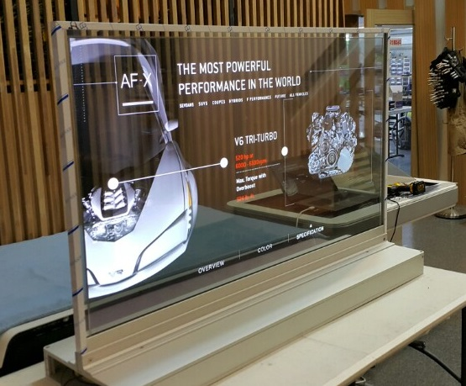
Transparent OLEDs
Uses transparent substrates on both sides
Improves contrast
Used in HUD technology and augmented reality
Notes:
-Contrast gives easier viewing in sunlight

Slide 5
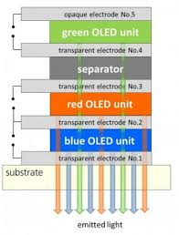
Stacked OLEDs
Uses pixel architecture to stack the red, green and blue subpixels
Better color depth
Smaller pixel gap

Slide 6
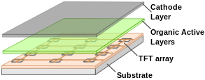
AMOLEDs
Active-matrix OLED
Thin-film transistor array
Used in smart watches, mobile devices, laptops, and televisions
Notes:
-Current flow is controlled by at least two TFTs at each pixel one to start and stop charging of the storage capacitor, one to create a constant current to the pixel, eliminating the need for high currents
-Most useful and common type

Slide 7
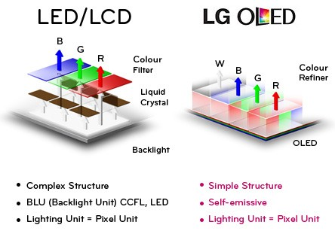
Comparing OLED to other Displays

Slide 8
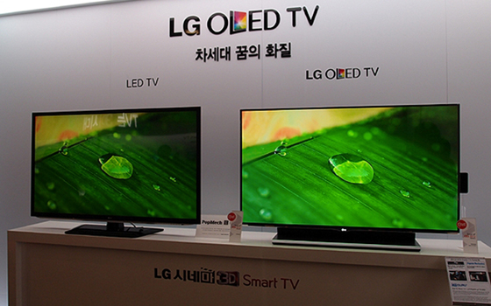
Advantages of OLED
Easier to produce/lower cost
Lightweight and Flexible
Better Picture Quality
More Power Efficient
Thinner
Faster Response Time
Notes:
-OLED displays can be printed on its substrate with an inkjet printer or screen printing, making it cheaper to produce as manufacturing increases.
-Because there is no backlighting, they can be produced on flexible materials
-Because OLEDs emit light directly it enables a greater contrast ratio and a much wider viewing range
-Since OLEDs are not backlit and produce pure light, they can save power and produce a true black at the same time
-OLEDs can have 1000 times faster refresh rates (10us)
-They are fast enough to be set to a flickering which can reduce motion blurr

Slide 9
Disadvantages of OLEDs
Shorter Lifespan ~40,000 hours compared to ~80,000
Color Balance
Water Damage
Whites consumer far more power
Notes:
-The organic material materials deplete faster than the typical semiconductor/silicon product
-The material that produces the blue light degrades significantly faster (1.5x) than the red and green components
-The organic materials are damaged a lot easier than its silicon counterpart
-Images with white backgrounds(word docs, websites) use up to 3 times as much power

Slide 10
Current Technologies
Mobile Phones
Vehicle Displays
Digital Cameras
Television
Monitors
Notes:
-vehicle displays are the central console units that control radio, heat/cooling etc.

Slide 11
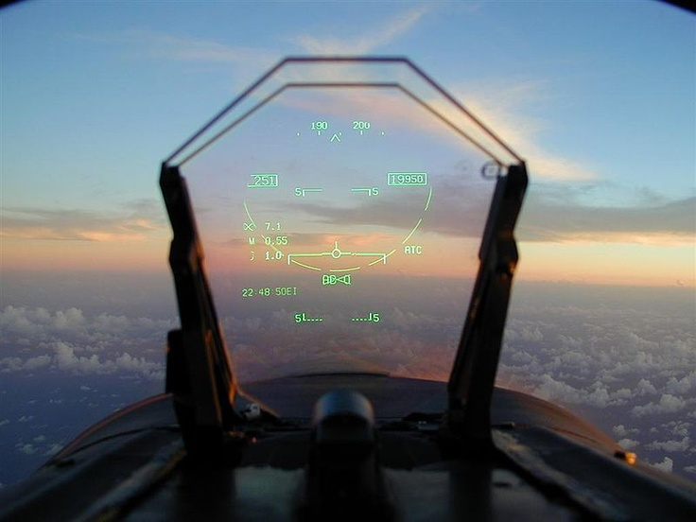
Future Technologies
Fashion/Clothing
HUDs
Expandable/Foldable Devices
Windows
Rolled Screens
Notes:
-Imagine having light up sneakers all over your body. You would be the coolest 6 year old in first grade.
-HUDs for aircraft/military uses as well as cars
-foldable tablets/laptops to condense
-windows would have many uses such as displaying on both sides, having displays in front of fireplaces etc.
-rolled screens could replace the need for projectors by just hooking up your device straight to the display

Slide 12
Conclusion
OLEDs are an incredible technology that has ever expanding uses. They have better quality in almost all areas over LED/LCD displays. Within a few years it will be cheaper to manufacture thus practically eliminating all over display options.

Slide 13
References
http://www.displaymate.com/LG_OLED_TV_ShootOut_1.htm#Response_time
http://www.explainthatstuff.com/how-oleds-and-leps-work.html
https://en.wikipedia.org/wiki/OLED
http://www.flatpanelshd.com/news.php?subaction=showfull&id=1446462482
https://www.provideocoalition.com/smallhd-dp7-pro-oled/
http://gizmodo.com/why-is-oled-different-and-what-makes-it-so-great-1654102034
https://www.osram.com/osram_com/tools-and-services/services/faq/ledoled-lighting/index.jsp

Slide 14
Five Key Points
Organic substrate instead of silicon or other like materials
Better color quality
Can be attached to flexible substrates
No backlighting needed
Can be used in transparent applications

