Slide 1
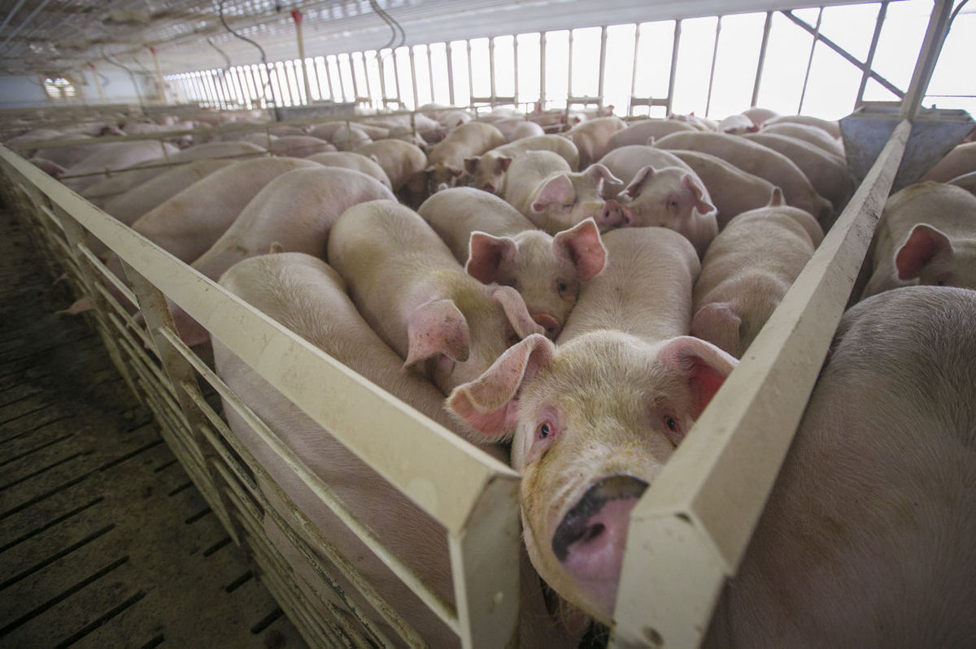
Badgerwood Farms
By: Lucas Hendrickson, Ian Strasburg, John Koets, and Shenquan Li

Slide 2
Badgerwood Farms
What is it?
  CAFO in Bayfield County Wisconsin
  26,000 pigs contained in three barns
    7,500 sows, 18,750 pigs, and 100 boars
  Hogs would be inside 365 days a year
Concerns
  Would introduce 6.5 million gallons of pig waste
  Lies within Fish Creek watershed
  Is 8 miles upstream of Lake Superior

Slide 3
Outline
Badgerwood Farm’s Proposal
  Potential Concerns
Evaluate Pig Fecal Matter and Storage Plan
  Contingency Plan
Potential Effects on Water
Nutrient Retention Using Wetlands
Economic Cost
Conclusion

Slide 4
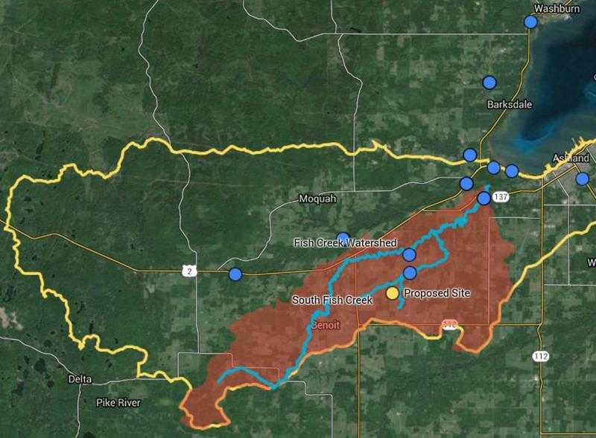
Fish Creek Watershed

Slide 5
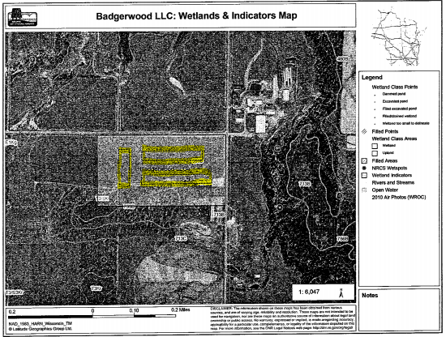
Wetland Map given by Engineering Report

Slide 6
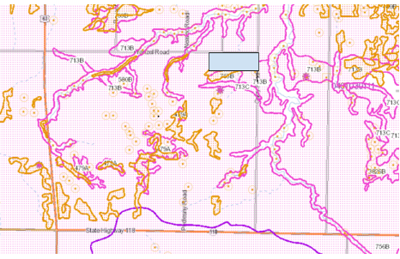
Current Wetlands

Slide 7
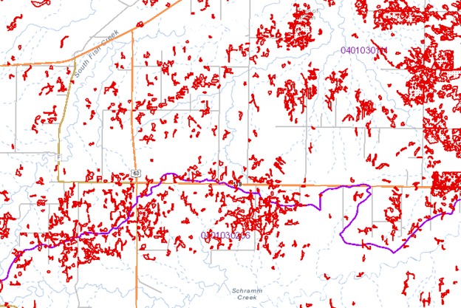
Wetlands with Restoration Potential

Slide 8
Pig Waste
Collected in bins below each barn
  Meant to contain 180 days of waste
  Reinforced concrete
  Not affected by stormwater
Used to be spread on fields
  Uses injection method
  Inject 10 inches into the ground

Slide 9
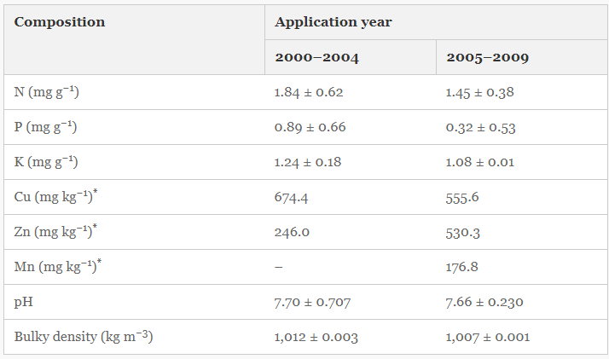
Composition of Pig Waste
Percent by Mass
Nitrogen
  0.184+/-0.062%
Phosphorus
  0.089+/-0.066%
Total per year
  Nitrogen
    45,328.4+/-15,273 kg
  Phosphorus
    21.925+/-16259.1 kg

Slide 10
Contingency Plan
Self reporting
  Daily, weekly, and monthly updates
If there is a leak
  Immediately create a trench to contain the spill
  If it comes into contact with a road, report to the city immediately
Drainage tile surrounds the tanks
Soil is predominantly clay with a thin layer of silt

Slide 11
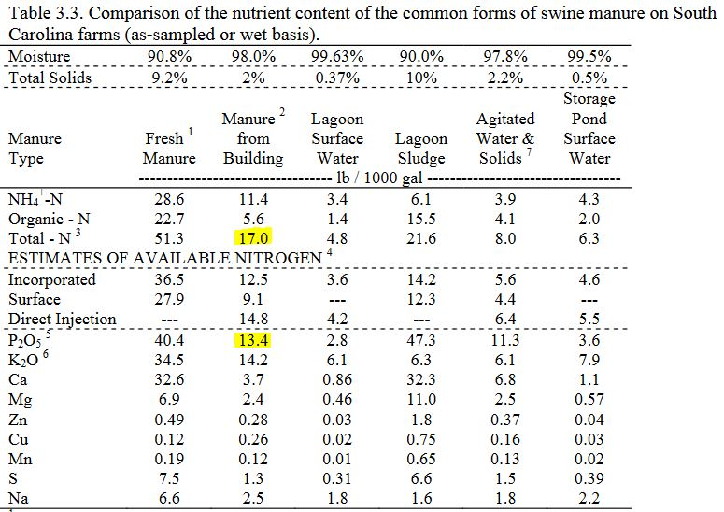
Available Nutrients
6.5 million gallons manure
880 total acres for spreading
56.8kg N/ acre
45.5kg P/ acre

Slide 12
Manure Use
Hay fields are the primary crop in Bayfield County
Depending on Hay type, fields can uptake around 83.4 kg N/ acre and 10.5 kg P/ acre
Nitrogen could be uptaken from hay but 35kg P/ acre would remain
Injection method capable of retaining 82% P, leaving 6.3kg P/ acre in runoff

Slide 13
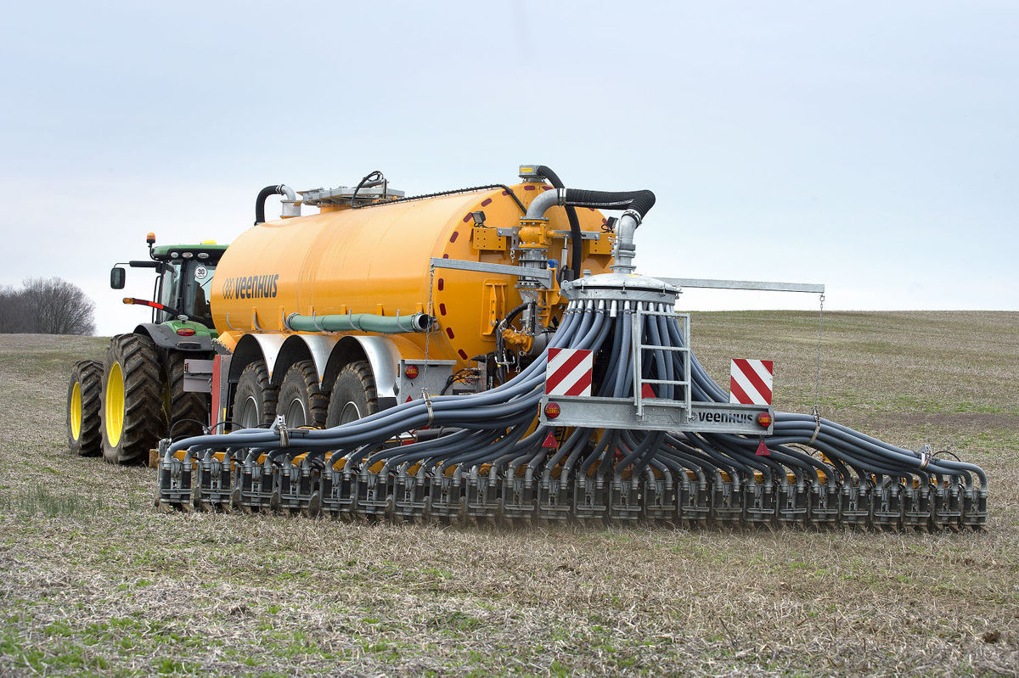
Manure Injection
Manure Retention 82% (ideal)
  Most Efficient Method
  Necessary for the Soil
Likely to become less efficient over time
Slight increase in nutrient load
  TP
  TN

Slide 14
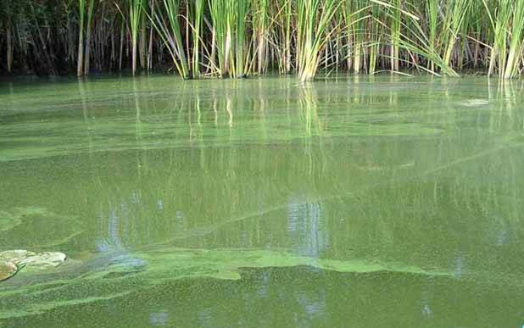
Increased Nutrient Load
Already Impaired
  Soils promote excessive runoff
  Watershed on impaired waters list (TP)
Boosted algal growth
  Eutrophication
  Hypoxia
Wetlands in the area are N limited
  Currently Researching
  Unknown Effect
Notes:
South FIsh Creek watershed was added to the

Slide 15
Many Unknowns
How much additional nutrients?
How much runoff?
What Impact?
  The watershed
  Lake Superior
  Coastal Wetlands

Slide 16
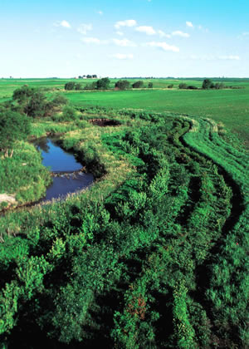
Riparian Buffer Strips
Vegetated strips along streams which can
uptake nitrogen and phosphorus
Gov. Dayton proposed mandatory 50 ft buffer
Strips around most Minnesota water bodies
Improve function by mowing and removing
vegetation

Slide 17
Buffer Space Needed
Using the excess P from hay fields and buffer strip ability to uptake P we found 387,692 square meters of buffer strip needed
10m wide buffer strips
38,769.2m long buffer strips
Assumed square 20 acre fields with buffer on three sides of fields
With these assumptions 37,554m buffer space available
1,215.2m of buffer still needed

Slide 18
Economic Cost of wetland establishment
Wetland easement costs
  Current land value
  The land value near the wetland
  Nuisance cost
  Good steward
Wetland restoration costs
  Size
  Hydology
  Flora and fauna

Slide 19
Major variables in Wetland Costs
Based on these drivers, size and type of wetland are the major independent variables in wetlands total cost.
For a given type of wetland, the cost of restoring the wetland hydrology and ecosystems and nuisance costs all related to the size of wetland.
For a given size of wetland, different types wetlands have different calculation models for total costs.

Slide 20
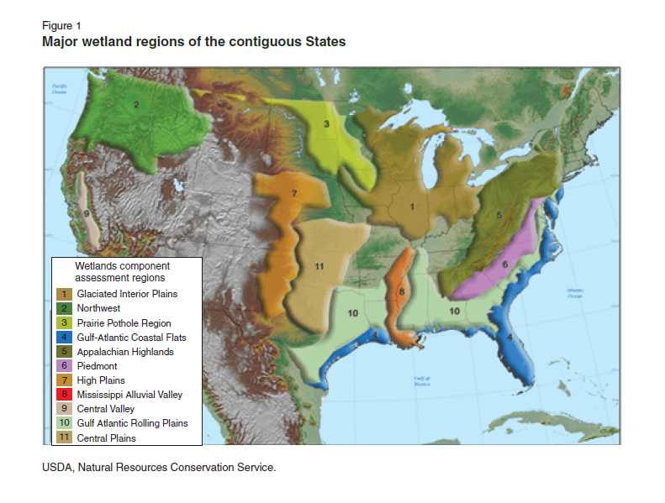
Different types wetland regions

Slide 21
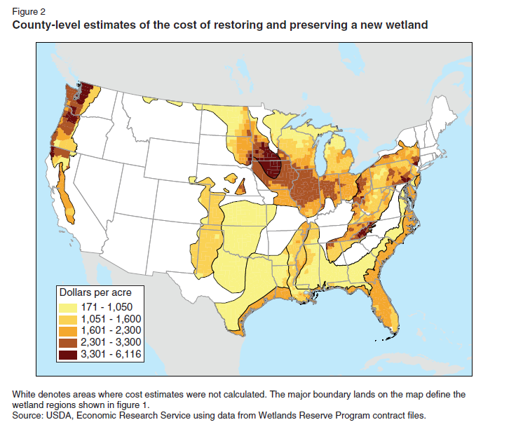
The costs through different regions

Slide 22
First year costs and Annualized costs
First year costs —— $ 1135 per acre
  Include Wetland design, Land rent, Constructing basin, Wetland plants, Seeding buffer, Control structure, etc
Annualized costs —— $ 800 per acre
  Include Wetland management, Control structure replacement, Land rent, flora and fauna management, etc

Slide 23
The total costs
The total buffer strip area of 387,692 m^2 or 95.8 acres to uptake the exceed nutrients.
First year wetland cost —— $ 108,733
Annualized wetland cost —— $76,640 per year.

Slide 24
Conclusion
Great variability in most aspects of the project
  Pig waste, nutrient uptake, retention, soil type, weather, farmers, government subsidies etc.
The numbers that were used in the calculations of waste held in barn facilities. Other studies support numbers in the upper range
Recommendation:
  Buffer strips could be used retain some nutrients, however at the scale proposed they would not be practical
  Scale back the scope of the facility
  Possibly reconsider the location of the facility

